Slide 1

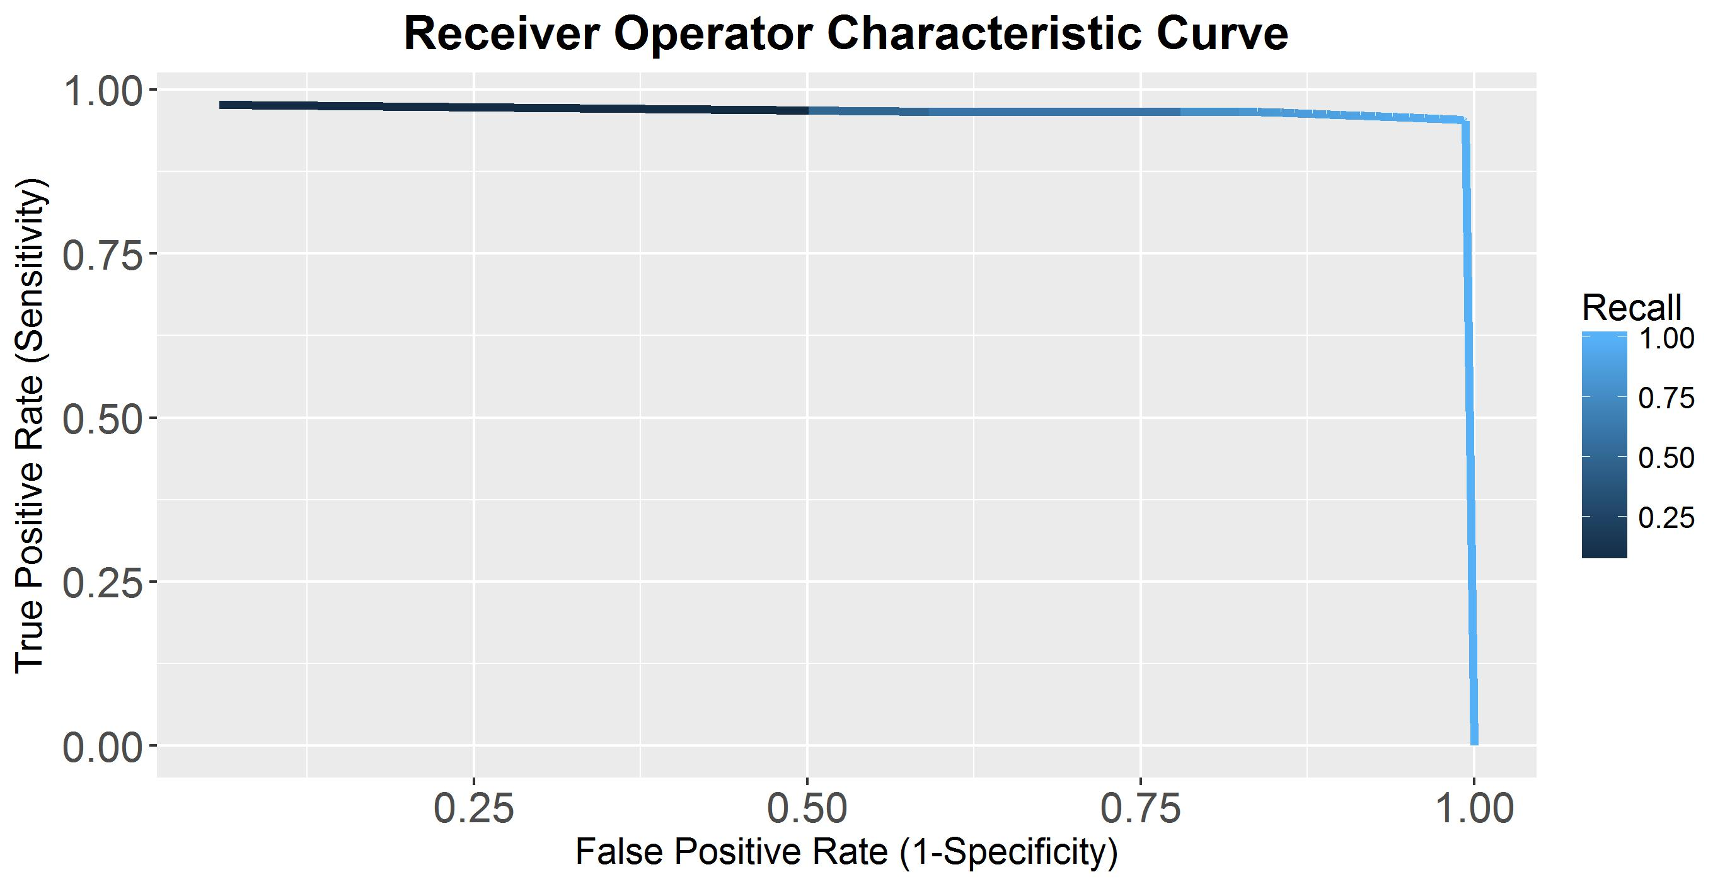
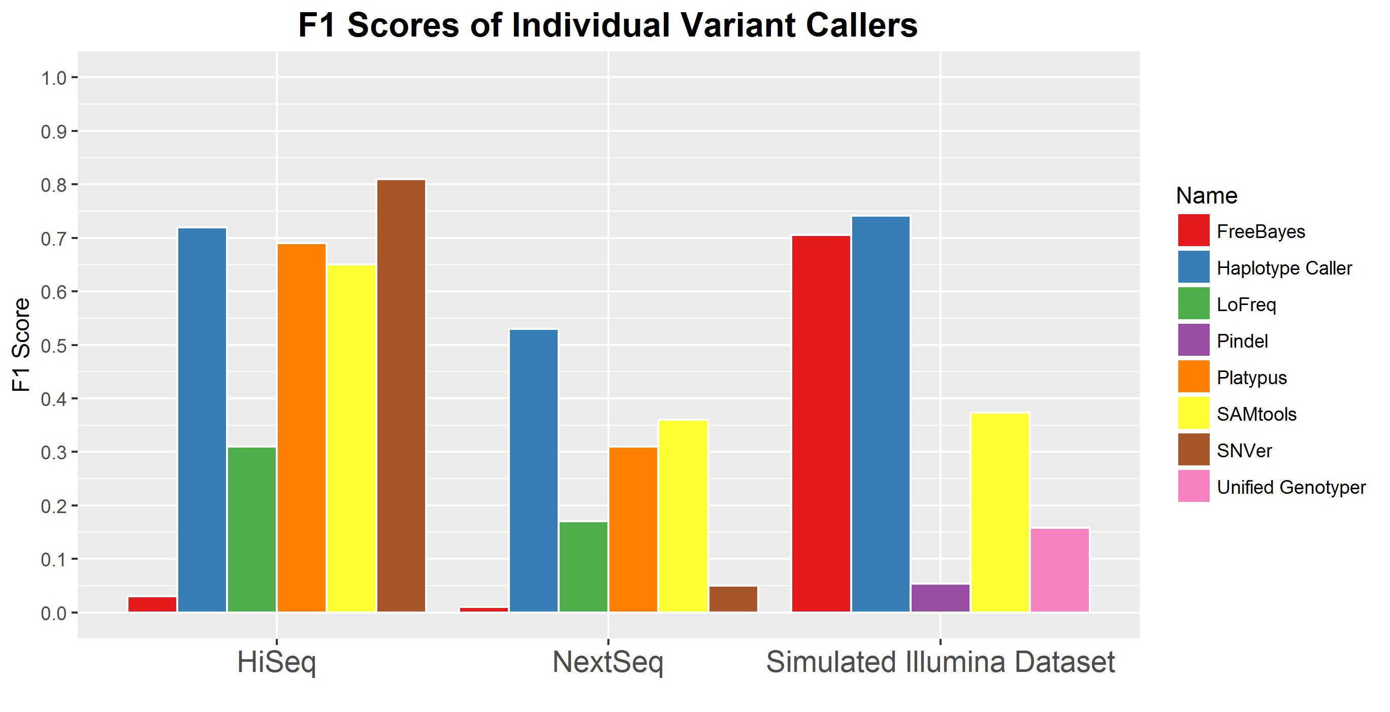
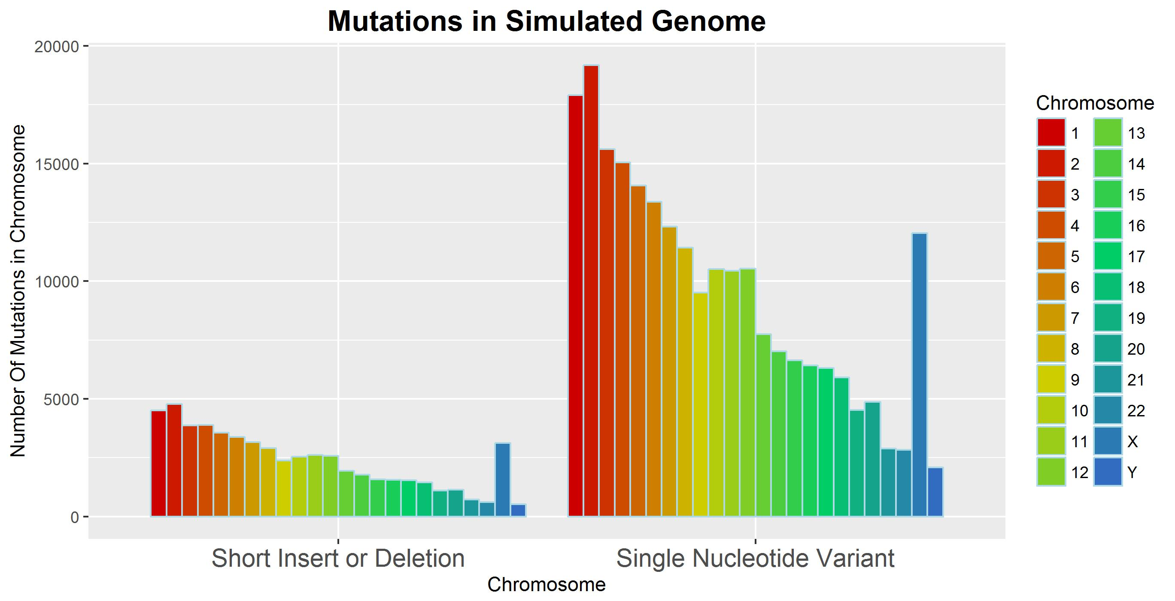
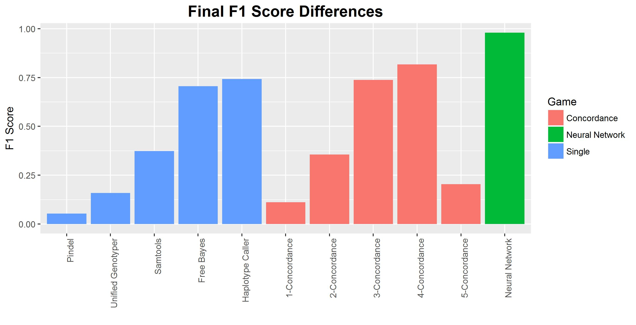
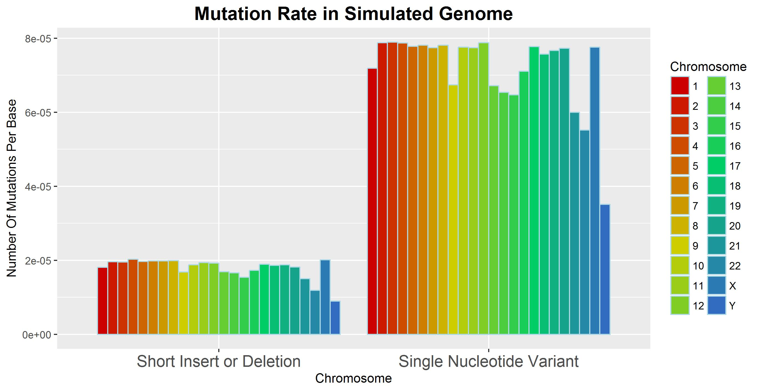
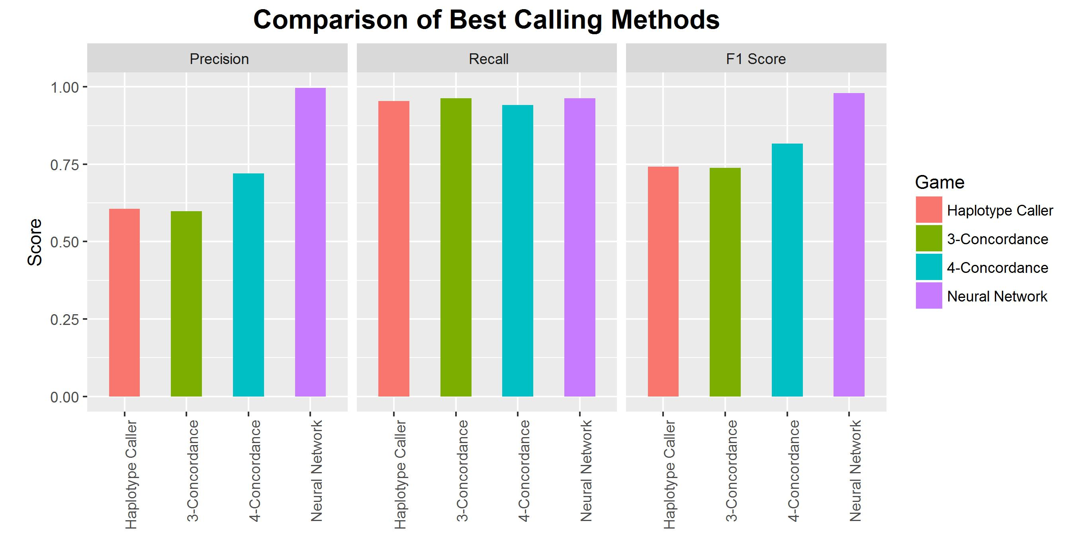
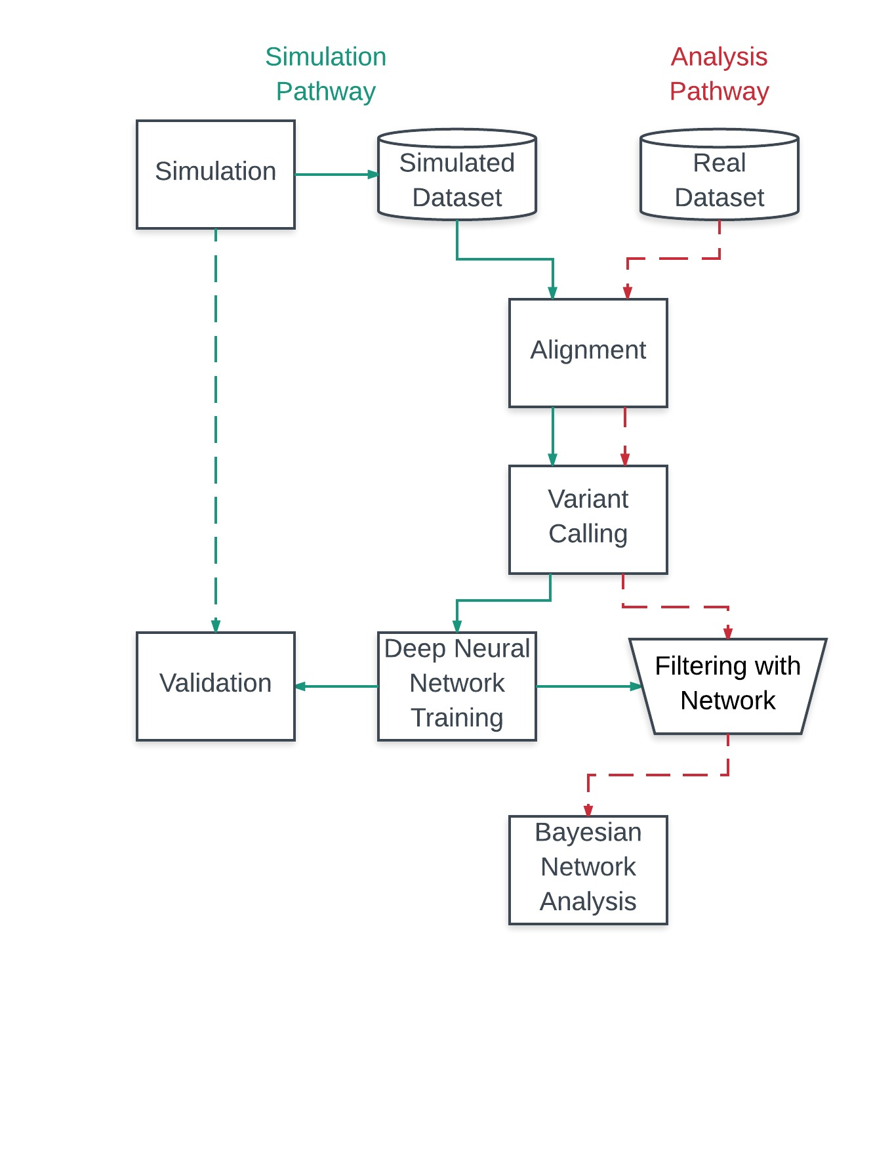
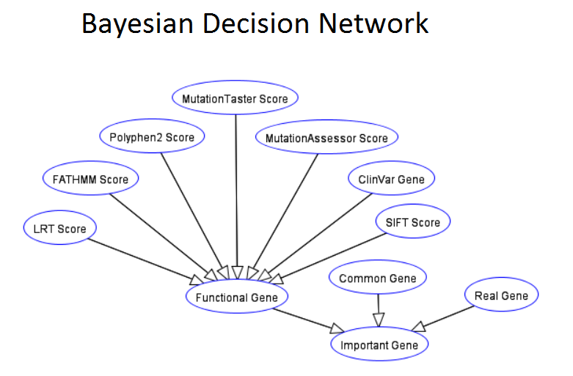
Deep Learning and Bayesian Classification in Determination of Important Genes in NGS data
Chan Khai Ern, Edwin, Kenneth Ban
Introduction
Feature Engineering
Variant Calling and Gene Identification are critical steps in NGS analysis
Features | Shannon Entropy (Reference Entropy, Alternate Entropy and KL- Divergence) | Base Composition (Longest Homopolymer Run, GC content) | Read Depth | Mapping Quality | Base Quality | Allele Balance | Quality by Depth | Allele Count | Genotype Likelihoods
fb | + | + | + | + | + | + |  |  | +
HC | + | + | + | + | + |  | + | + | +
UG | + | + | + | + | + | + | + | + | +
pindel | + | + | + |  |  |  |  |  | +
samtools (BCF) | + | + | + | + | + | + |  |  | +
Annotating and Identifying Important Variants
Variant Calling
Annotation
and Identification
Research and Clinical Applications
Identifying Important Variants with Algorithms and Software
Supporting Medical Diagnosis and Treatment
Genetic Research and Functional Discovery
Phylogenetic and Evolutionary Studies
Results
Final Neural Network Characteristics
Generation of Synthetic
Illumina Datasets - BAM ALIGNMENTS?
However, variant calling is a critical step in NGS genome analysis
Determination of Important Genes
Hypothesis
Network Architecture
PDX Sequencing Results
PDX Analysis Results
Methods
Sample Balancing
Summary
Future Directions
Analysis on NA Dataset

